Slide 1


Autonomous Baby Incubator
Instrumentation and control lab mini project
[REDACTED]

Slide 2
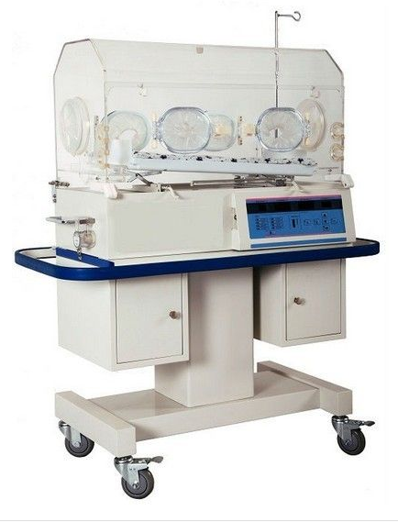
Introduction
Baby incubator is a device that provide a living environment to premature babies by controlling the temperature and humidity inside it.
Premature babies requires special treatment when they are born, they have underdeveloped internal organs and soft skin they cannot sustain environment that’s why they should be placed in a incubator.
Sometimes normally developed babies, those who has medical conditions are also kept in a incubator.

Slide 3
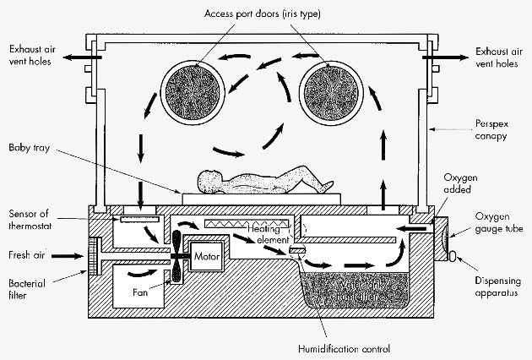
Working
Its working principle is very simple, it provides temperature from a heating element and humidity from a humidity source in our case Ultrasonic mist maker.
The heat and humidity is circulated via a fan throughout the incubator.
The control components are placed below the baby chamber, as shown in figure.

Slide 4
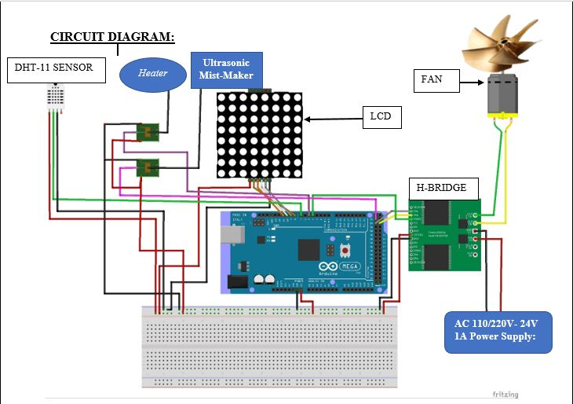
Control system circuit diagram
Arduino
H-bridge
Dot LCD
Relay
Temperature & Humidity sensor
Power Supply
Breadboard
Heating Source.
Humidification Source.
Fan.

Slide 5

How these components interlinks
The Arduino reads the value from the sensor and then actuates heater, mist-maker and fan accordingly.
$$error={value}_{inside}−{value}_{set}$$
For temperature when error is negative the controller will turn the heater on and vice versa.
The same logic is followed for humidity.
Finally when the set conditions are achieved the system will set LOW values for all actuators and will respond to any changes.

Slide 6
References
References
[REDACTED]1, J. P. ([REDACTED] ). PIC Microcontroller based baby incubator using sensors. International Research Journal of Engineering and Technology (IRJET) , 1906-1910.
Zain-Aldeen S. A.Rahman1, F. S. ([REDACTED]). Smart Incubator Based on PID Controller. International Research Journal of Engineering and Technology (IRJET), 2501-2509.
THANK YOU

